Slide 1
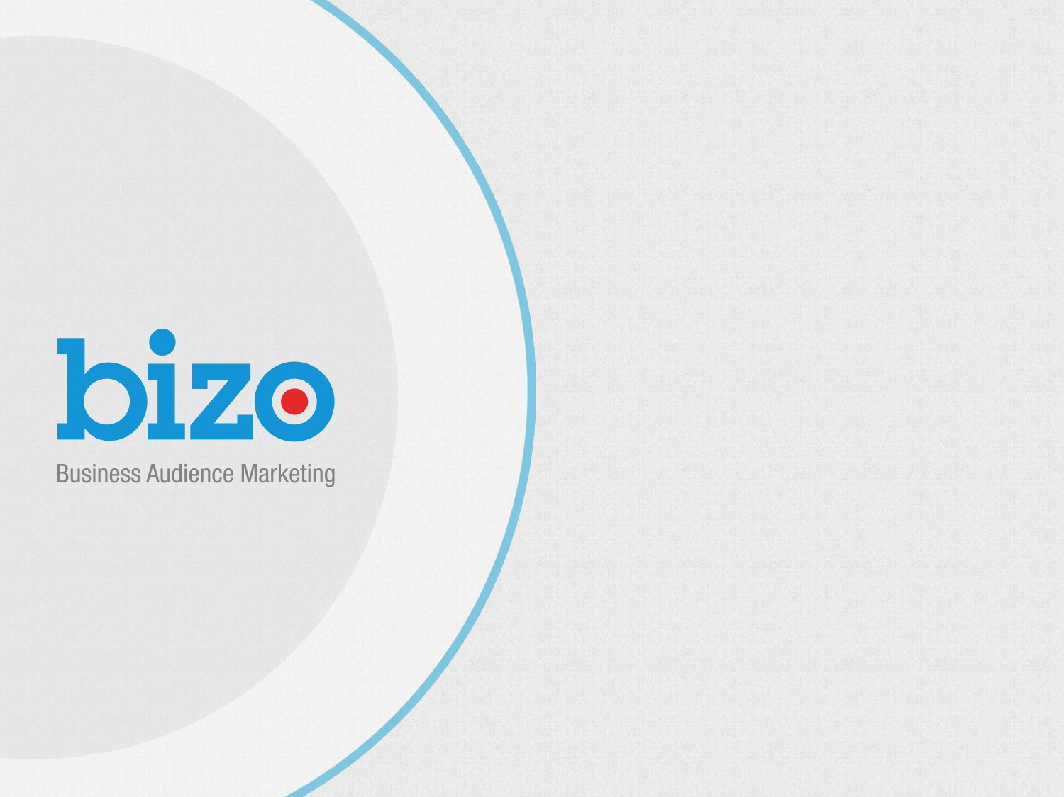

Slide 2

State of the Industry
Audience targeting continues to grow with more than 80% of advertisers and 90% of agencies, ad networks, ad exchanges and DSPs utilizing the capability
Over 60% of advertisers prefer 3rd party online data for audience targeting, followed by 1st party CRM data
3rd party online data is the highest ranked data set for both direct response and branding campaigns for both advertisers and agencies
More than 69% of respondents report they plan to increase their audience-targeting budgets, with an average budget increase of 38%
Key highlights from the eXelate and Digiday State of the Industry survey – May, 2013
Notes:
3rd Party online data - , outperforming 1st-party social, custom and CRM data, as well as 3rd-party offline data

Slide 3

Bizo
BACKGROUNDER
FOUNDED
4200+
120 MM+
2/3
2008
B2B Publisher
Sites
Biz Professionals
OF TOP 50 B2B BRANDS
Bizo
Audience Marketing
Platform
Reach approx. 85.%
BPA
NO
U.S. Biz Pop
Audited, Verified
& Certified
PII
#62
258 B2B
110
ON FORBES TOP 100 MOST PROMISING COMPANIES
Bizo Segments
EMPLOYEES

Slide 4

Bizo’s Business Audience Demographic Targeting Helps Marketers:
Capitalize on the value of the business professional audience at scale
Improve branding efforts and campaign ROI
Provide potential optimization and upsell opportunities

Slide 5
Private Audience Targeting
Helps Publishers:
Unlock the value of your audience at scale
Provide a potential upsell opportunity for their sales teams
Upsell their advertisers with the ability to target high value ads to specific business demographic segments, improving campaign ROI

Slide 6


Company Size
Fortune 500
X-Large (5001+ employees)
Large (1000 - 5000)
Medium (101 - 1000)
Small (21 - 100)
Micro (1-20)
Job Function
Industry
120+
C-Suite
Consultants
Education
Engineering/Technical
Finance
Government
Human Resources
Information Technology
Management Consulting
Consumer Services
Cultural
Education
Energy & Utilities
Finance
Government
MILLION
Company Size
Accounting Services
Advertising & Marketing
Agriculture
Architecture
Business Services
Commercial Printing
Construction
targetable
business
professionals
Legal
Marketing
Medical & Health
Nurse
Operations
Sales
Scientists
Job Function
Industry
120M+
Seniority
Professional
Segments
Professional
Segments
Seniority
Business Professionals
Executives
Mid-management
Non-management
more...
Small Business Professionals
High Net Worth Professionals
Finance Professionals
IT Professionals
The Bizo platform and business audience data have been audited and certified by BPA Worldwide

Slide 7




The
Data
Factory
COLLECT
NORMALIZE
Data is collected
via 5 methods:
PROTECT
REGISTRATION
VERTICAL BUSINESS PUBLISHERS
DISTRIBUTE
PROPRIETARY IP CONVERSION
FUEL
OFFLINE DATABASES
E-MAIL DATA

Slide 8

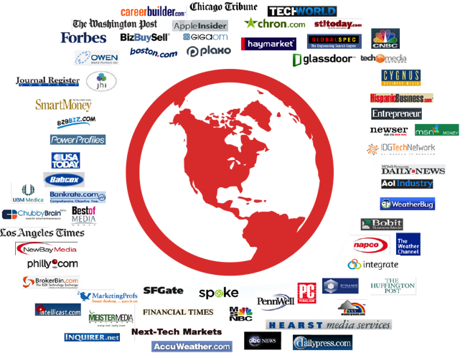
The Source
of
Bizo’s Data

Slide 9























LEADING GLOBAL BRANDS
Supporting
over
600
SMB Marketers and Leading Global Brands

Slide 10

TOP FUNNEL
IMPACT
focus on
(Brand Awareness)
RESULTS
Target Audience: Sales & Marketing Professionals
Goals: Increase awareness of brand and products, boost impact of other programs, drive conversions
Results: 32% lift in brand recall; 80% lift in branded search; 355% increase in pages viewed per visitor; 30% lift in form conversion rates; drove 354 key conversions, influenced another 2300 conversions

Slide 11
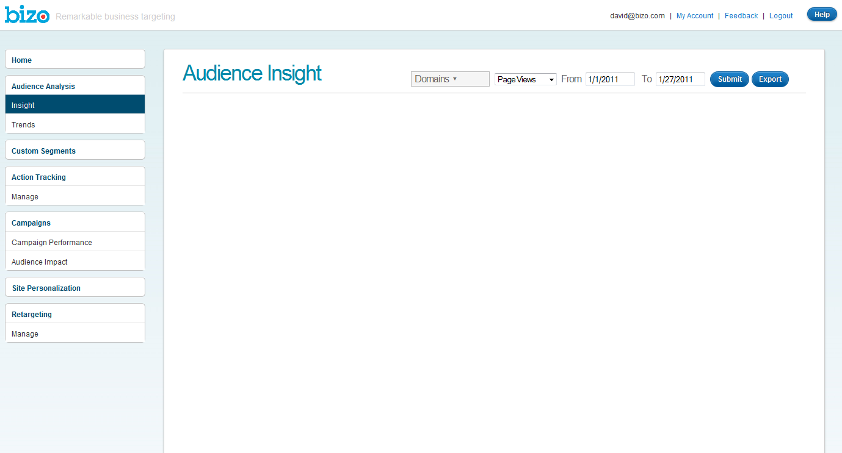
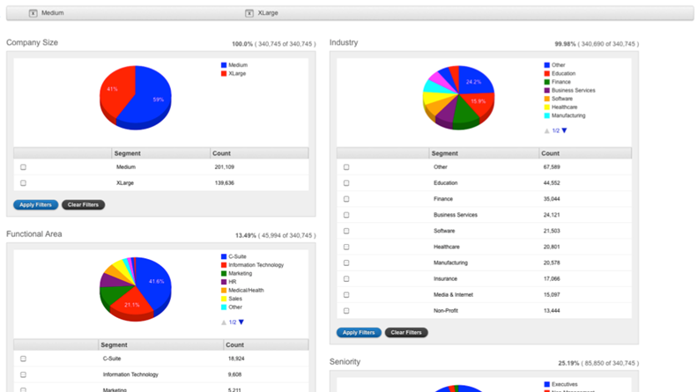
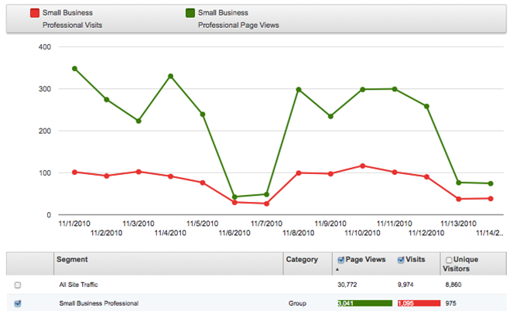
Bizo Audience Analytics
Audience Reports can provide a detailed breakdown of the Bizographic of your site along with a vivid visualization of site visitation and other metrics (page views, unique visitors)

Slide 12
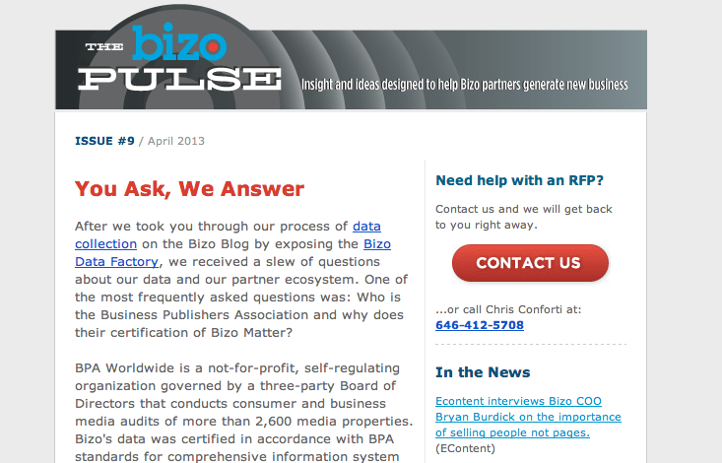
Partner Success Zone
Visit: http://partners.bizo.com
The Bizo Partner Success Zone is a site containing various resources that partners can access to help them position Bizo targeting capabilities with clients and generate new business:
Data Sheets, White Papers and Case Studies
Presentation Slides
Contact Information
Bizo Logos
Also in the zone - sign up for the
Bizo Pulse monthly newsletter
to stay current on all things Bizo
partner ecosystem.

Slide 13


Partnership
Partnership indexes Bizo’s Audience against comScore’s database
Provides insight into content consumption habits and propensity to purchase online and average purchase size across various categories

Slide 14
Quarterly Updates and Needs Assessment
Co-Branded Sales Collateral
Partner Portal
Bizo Pulse
Dedicated RFP Support

